Slide 1

dynaTrace by Troy Wellinghurst

Slide 2
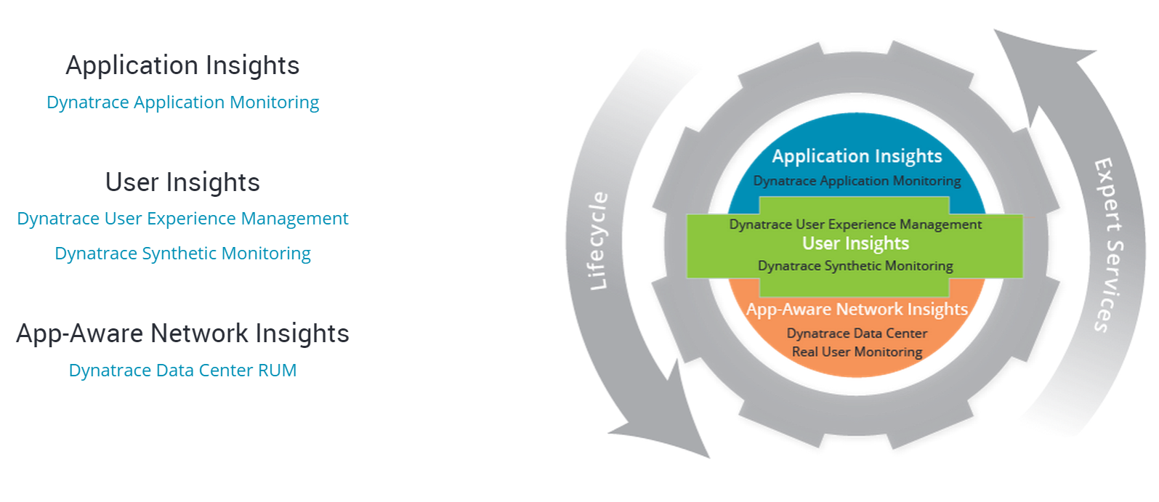
dynaTrace
-Application Monitoring
-User Experience Management
-RUM (Real User Monitoring)
-Synthetic Monitoring***

Slide 3
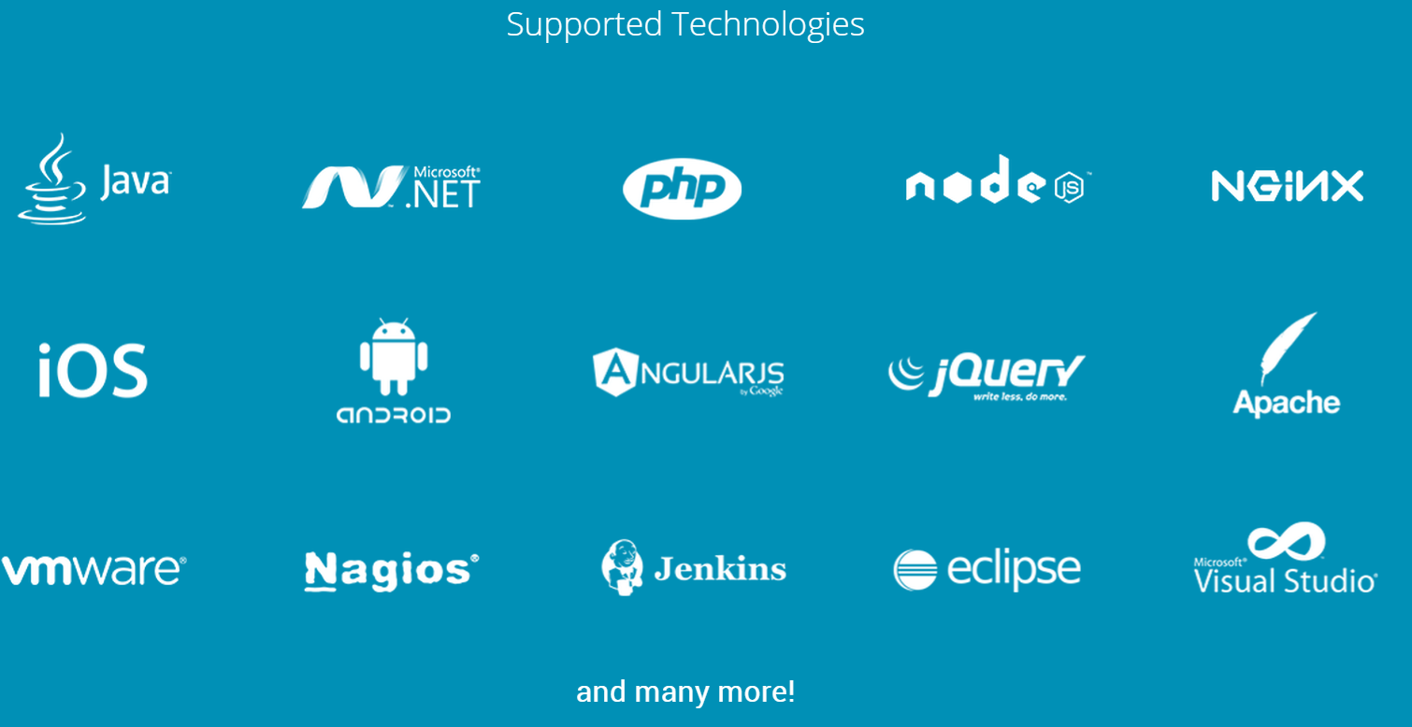
dynaTrace

Slide 4

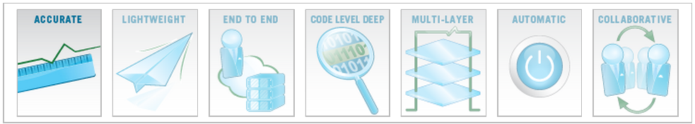
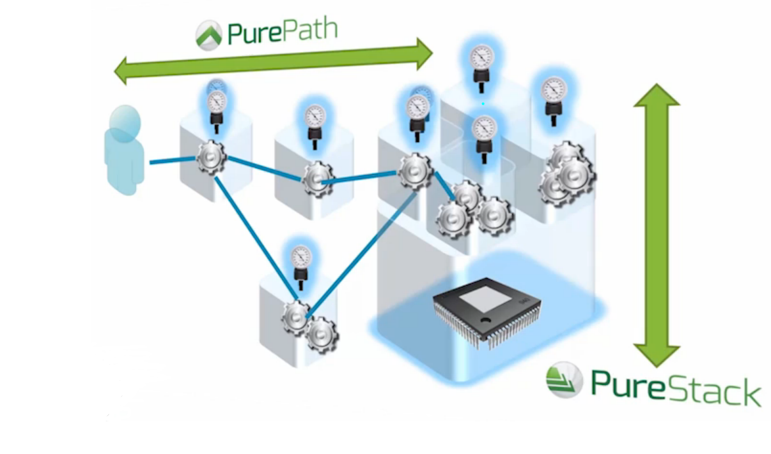
dynaTrace

Slide 5


dynaTrace
PurePath Technology® captures timing and code level context for all transactions, end-to-end, from user click, across all tiers, to the database of record and back.
PureStack® Technology directly correlates guest and host infrastructure health to individual application transactions and affected end users in real-time.

Slide 6
dynaTrace
What is Synthetic Monitoring?
Synthetic monitoring is website monitoring that is done using a web browser emulation or scripted recordings of web transactions. Behavioral scripts (or paths) are created to simulate an action or path that a customer or end-user would take on a site.

Slide 7
dynaTrace
Different Types of Synthetic Monitoring:
-Backbone: Tests are run from dynaTrace backbone nodes.
-Last Mile: Tests are run using dynaTrace Last Mile nodes.
-Private Last Mile: Tests are run from private servers or end-user machines with software agents installed.

Slide 8
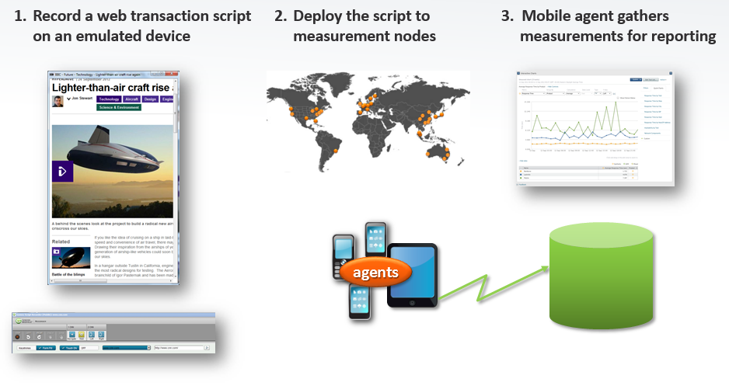
dynaTrace

Slide 9
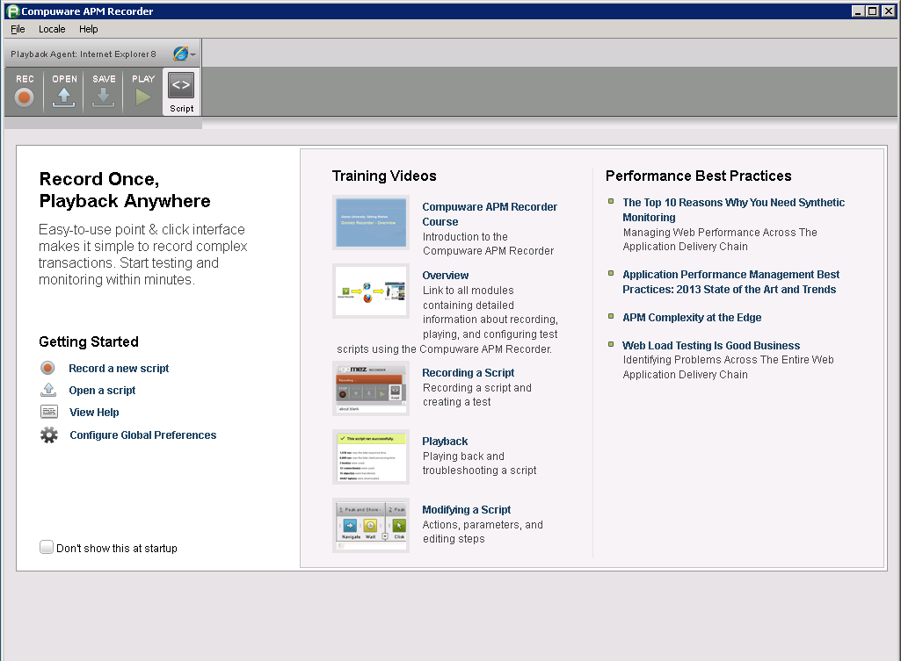
dynaTrace

Slide 10
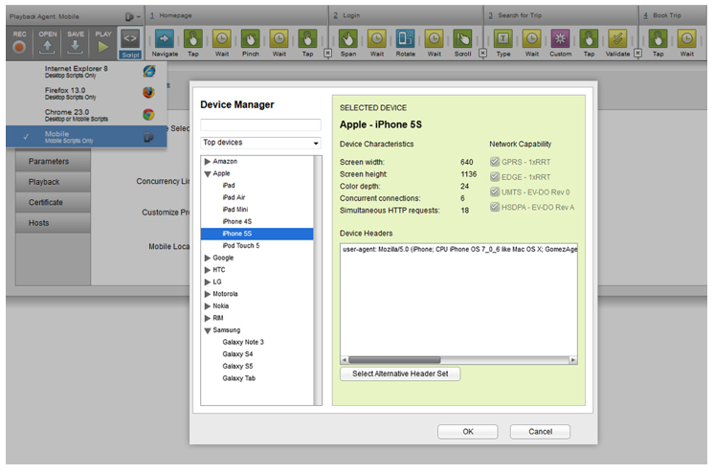
dynaTrace

Slide 11
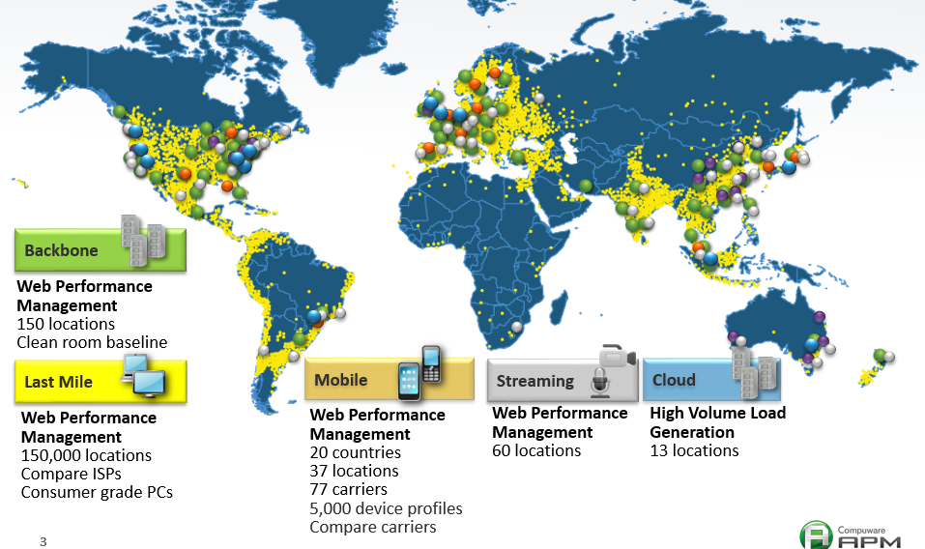
dynaTrace

Slide 12
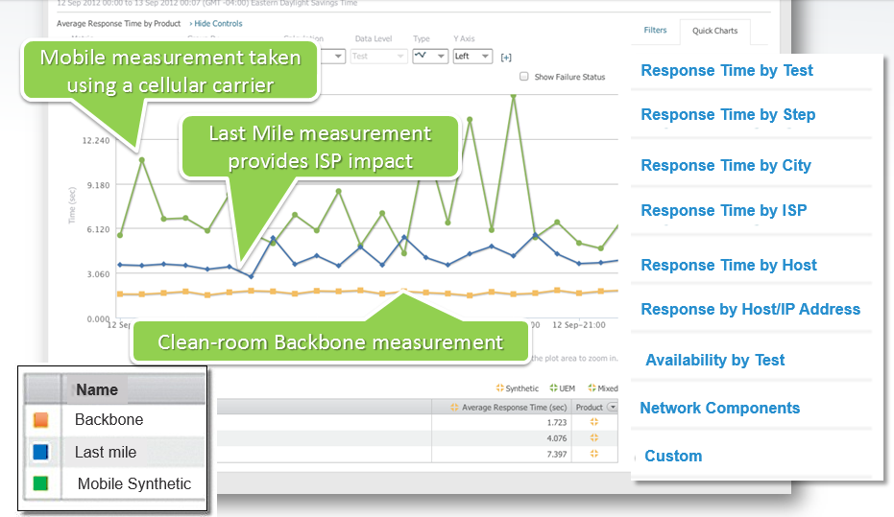
dynaTrace
-Start comparing measurements

Slide 13
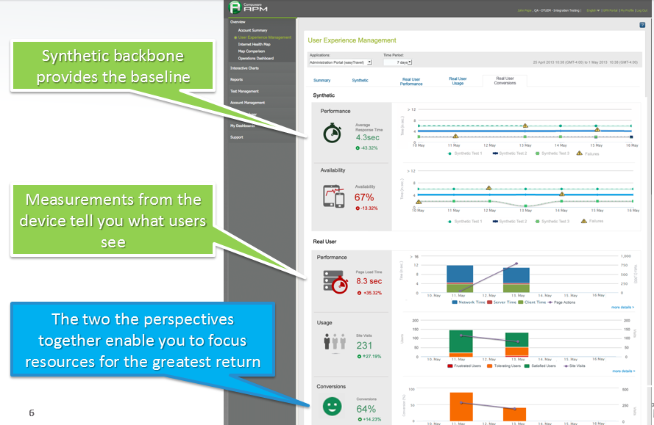
dynaTrace

Slide 14
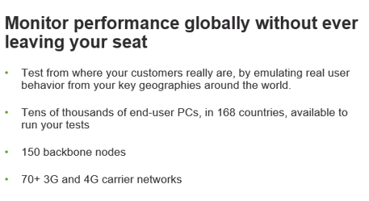
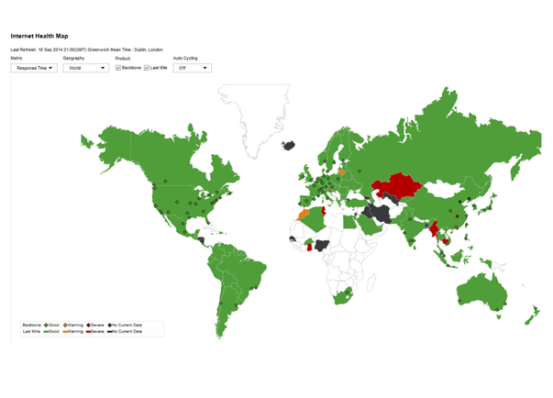
dynaTrace

Slide 15
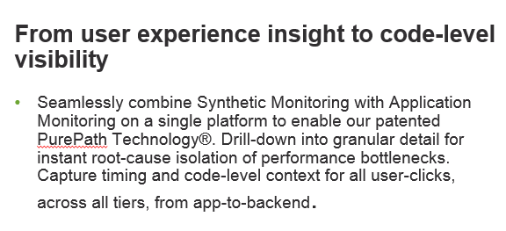
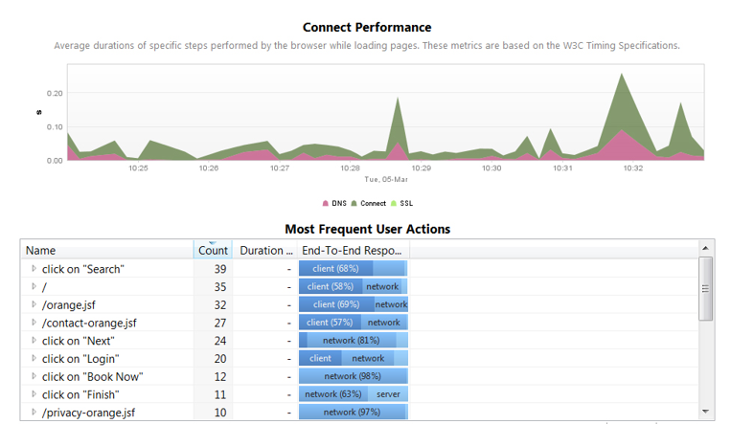
dynaTrace

Slide 16
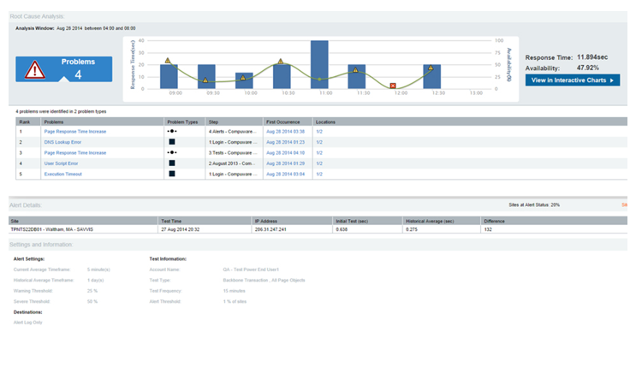
dynaTrace

Slide 17
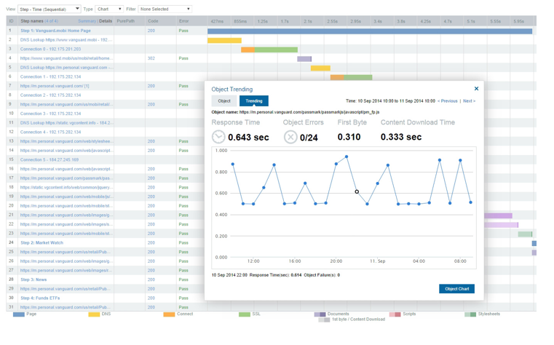
dynaTrace

Slide 18
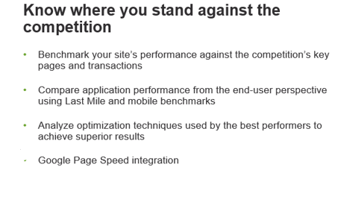
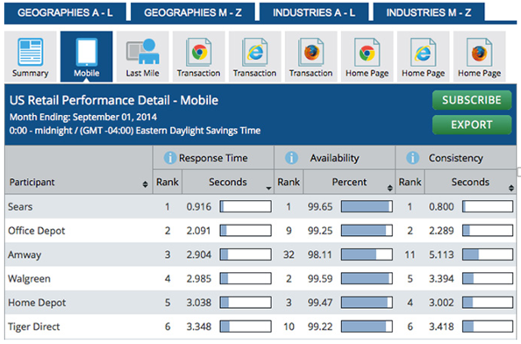
dynaTrace

Slide 19
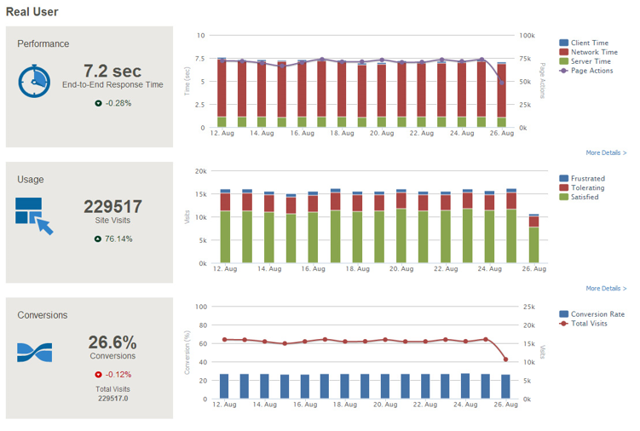
dynaTrace

Slide 20

Works Cited
http://www.compuware.com/
http://www.dynatrace.com/
http://www.support.dynatrace.com/

